Slide 1
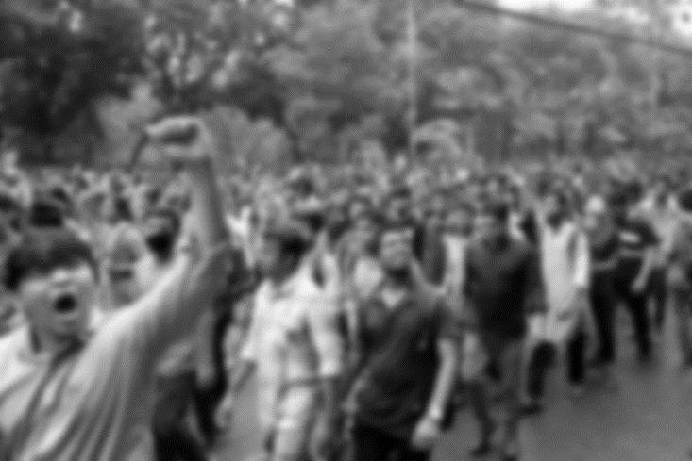
Should Student Politics Be Banned
in Bangladesh?
Prepared by:
Md Sharif Hossain
ID: 1712336642

Slide 2

What is Student politics?

Slide 3
Student politics
An union of youth students who practice politics and act as a student wing of any political party.
They start to learn about nationalism, their humanitarian, national and political rights in a practical field.

Slide 4
Should it be banned in the universities in Bangladesh?
YES | NO

Slide 5
NO, It should not be banned!
Defending Theory: Deontology

Slide 6
What is Deontology
Deontology (deon= duty)
Rightness of action depends on its relation to duty.
Focus is on what I do and why I do it.
Happiness is not the highest good. According to Kant, there is something BETTER than being happy and that is: being WORTHY of being happy.

Slide 7
What is Duty?
Duty arises from a Law
Relative duties come from relative laws
Moral duty arises from Moral Laws
Moral Law determines our will rationally

Slide 8
What is Will?
Will is part of us that is influenced by reason
Only rational creatures have a will
To have a will, one needs to be able to determine one’s action, to be free and to be able to give ourselves the law behind the action.
Only creatures with a will can be moral

Slide 9
The will behind Student Politics
Enrich the feelings of Nationalism
Focus on the internal affairs of a specific institution
Focus on broader issues such as a war or dictatorship
Focus on a regional or national policy's impact on the institution, such as a campaign against government education policy.

Slide 10
Good will tends to Right action

Slide 11
What is the problem?
Giving limitless power and illegal shelter to the ruling party students
Lack of judgement
Not obeying law and ethics

Slide 12
Possible Solution
Ensure proper judgements of laws
Controlling and monitoring properly by the authority.
Learn and practice philosophy and Ethics

Slide 13
Thank you all!

